Slide 1
TOPAZ ENGINEERING
(Aerospace & Defense)
ISO 9001: 2015 & AS 9100-D Certified
Office & Works :
Plot No. 8 & 9B/22, Bandlaguda, IDA Phase -1, Patancheru,
Sangareddy Dist, Telangana State – 502 319.
Phone : +91 9059392710, +91 9912492710
info@topazengineering.in, marketing@topazengineering.in
topazengineering17@gamil.com
Web: www.topazengineering.in

Slide 2
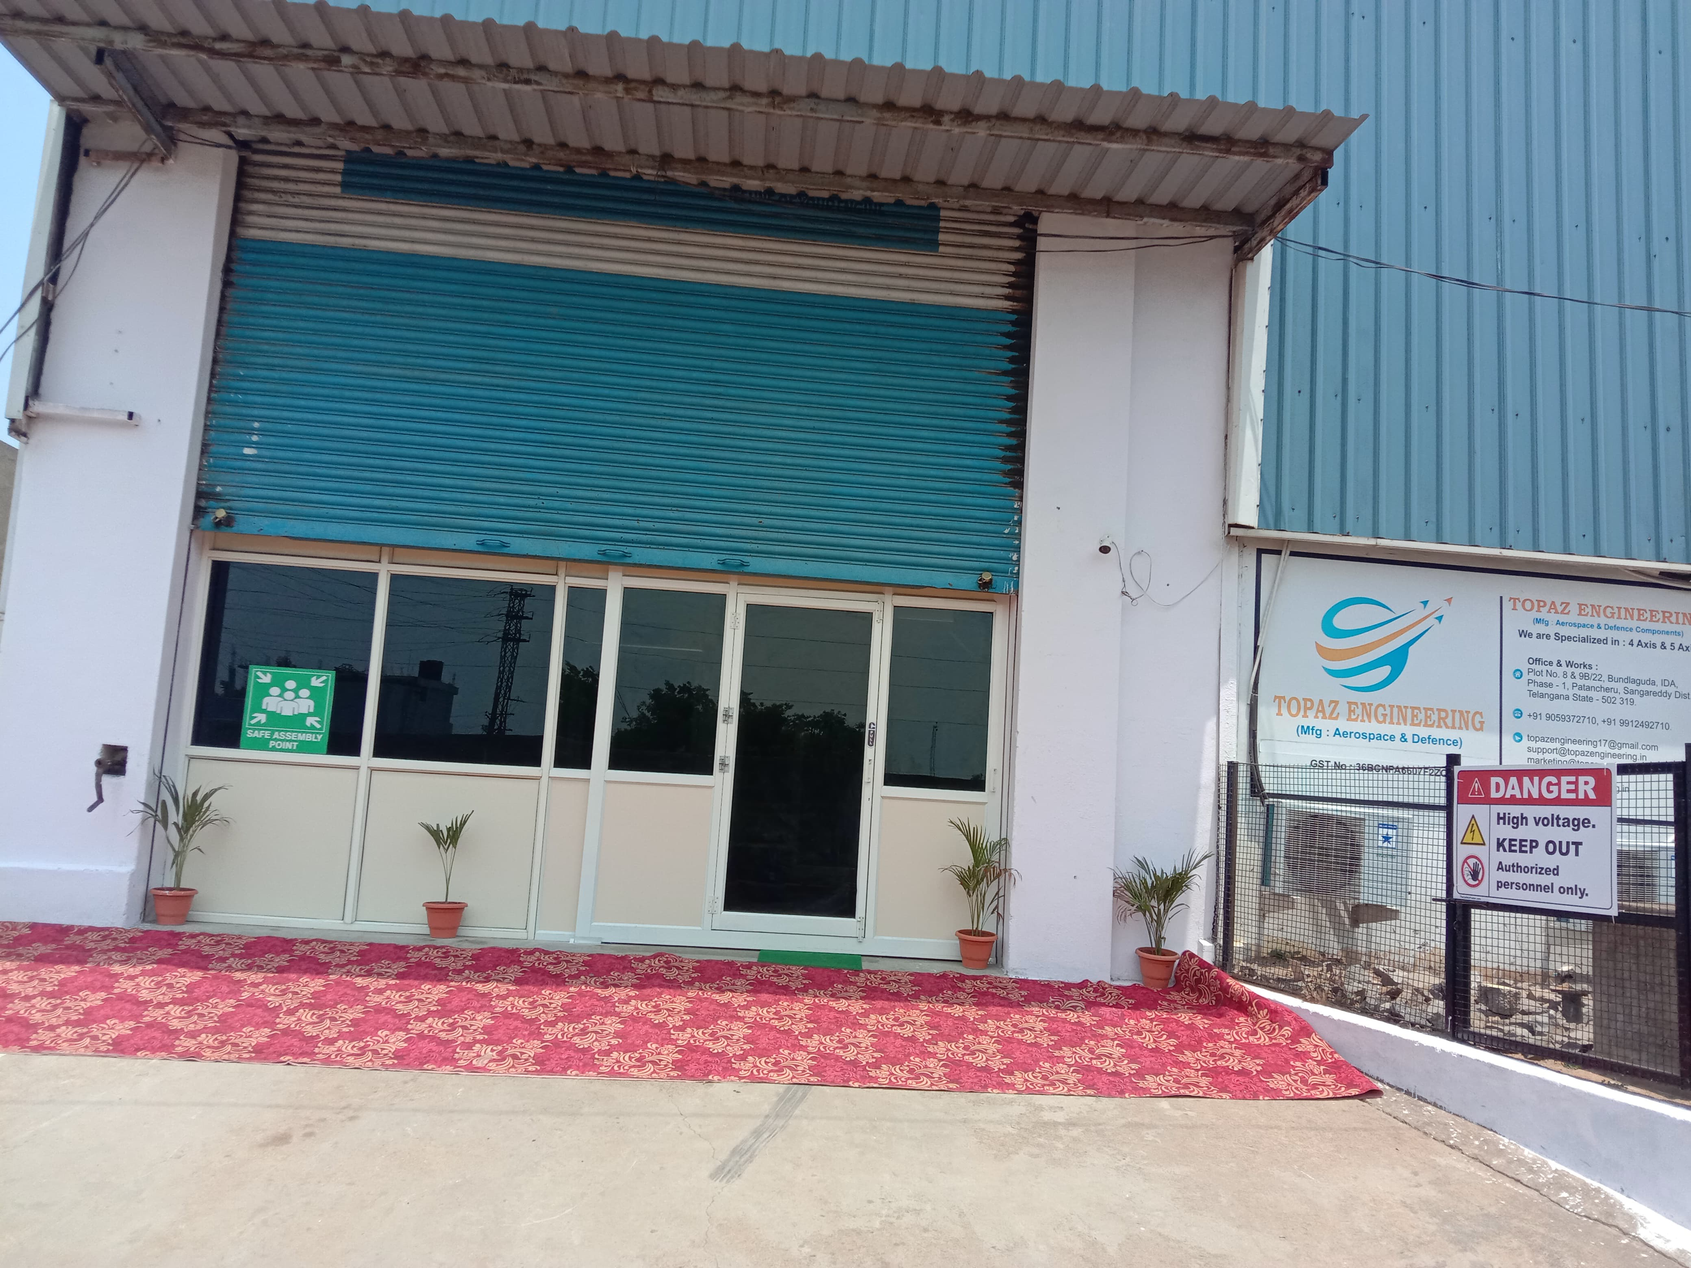
ABOUT US
Topaz Engineering is for manufacturing of High Quality critical components of Aerospace,
Defense & Marine Sectors.
Established in the year 2017 at Hyderabad.
We take up challenging & development projects
of Technology intensive Aerospace Class Assemblies.
We have inhouse Design Centre
We have independent Quality control Department

Slide 3
MISSION
Topaz Engineering to be the BEST for Design, Development & Manufacture
of Products used in Strategic applications
VISION
Topaz Engineering to be a Preferred organization for the Customers, in
providing solutions with utmost focus through application of Innovative
Technologies

Slide 4
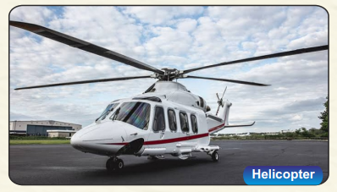
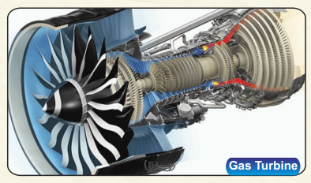
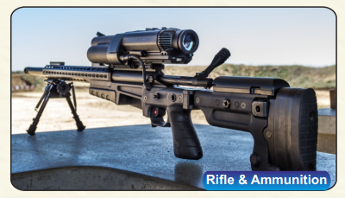
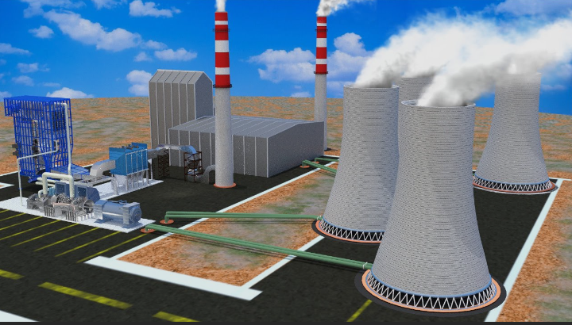
AEROSPACE & DEFENSE DOMAINS
Oil & Gas
Thermal Power

Slide 5
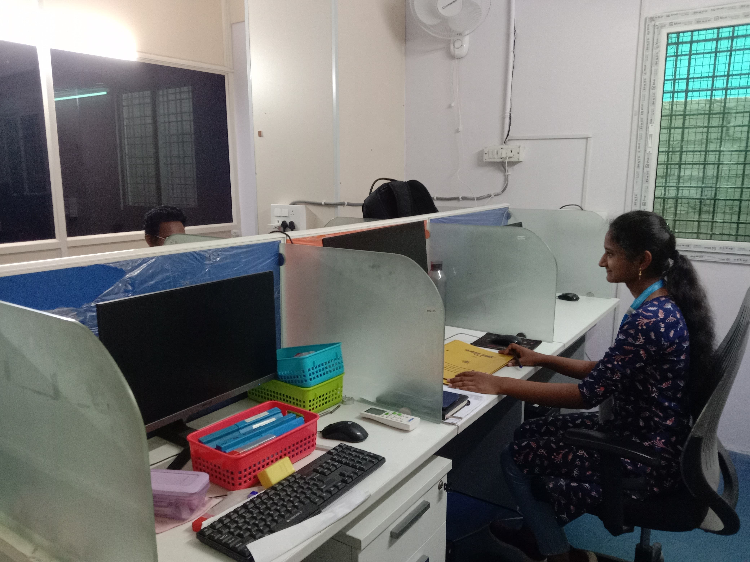
DESIGN CENTRE
We have Mastered in Design Solutions required for Aerospace & Defense.
We have Designed & Developed various Jigs & Fixtures for day to day machining
We have Licensed CAD/CAM Software's(SOLID WORKS, MASTER CAM)
to meet our production requirements

Slide 6
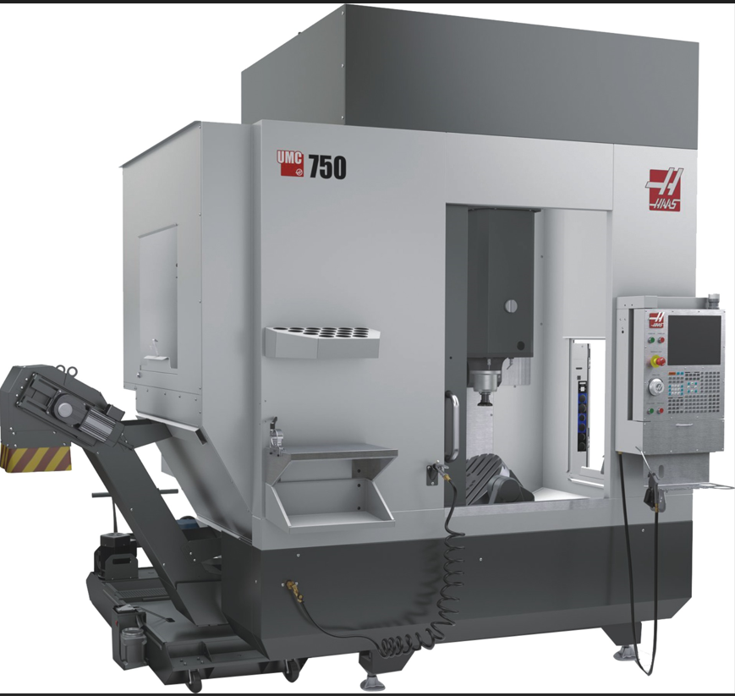
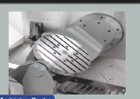
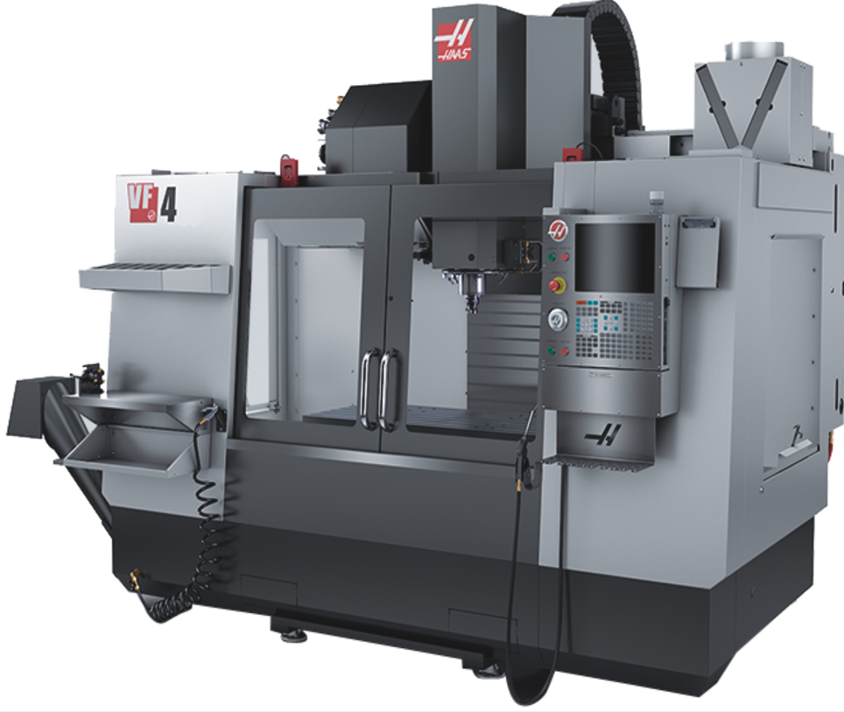
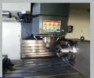
CNC VERTICAL MACHINING CENTRES
4 AXES MACHINING CENTRE
X: 1275 mm
Y: 450 mm
Z: 650 mm
Make : HAAS
5 AXES MACHINING CENTRE
X: 750 mm
Y: 600 mm
Z: 650 mm
Make : HAAS

Slide 7
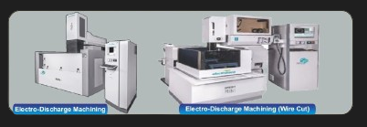
CNC MACHINING CENTRES
5 AXES VERTICAL MACHINING CENTRE
X: 800 mm
Y: 550 mm
Z: 650 mm
Make : Manford
EDM & EDM WIRE CUT MACHINES
X: 800 mm
Y: 600 mm
Z: 850 mm
Make : Electronica

Slide 8
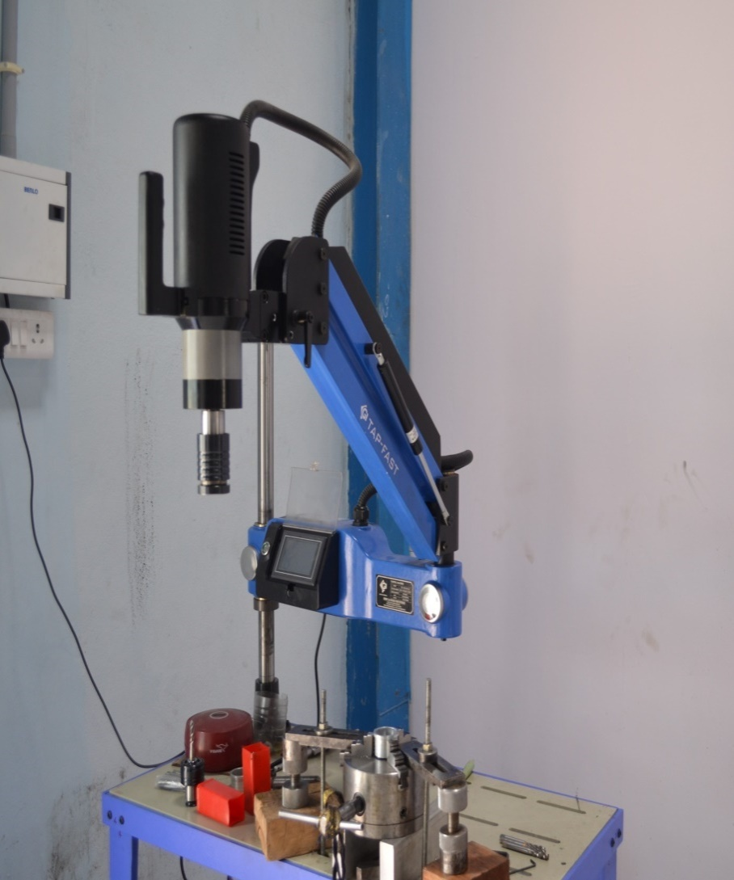
CNC TURN MILL & TURNING CENTRES
TURN MILL & TURNING CENTRES
X: 500 mm
Y: 100 mm
Z: 550 mm
Make : HAAS (ST10Y)
OPERATION : 40/50 TAPPING
CAPACITY : M32
Make : SRI GANESH

Slide 9
PLANT AND MACHINERY DETAILS
SNO | DESCRIPTION | MAKE & SPECIFICATION | QUANTITY
1 | CNC MILLING 5-AXIS | HASS UMC 750 750X500X650(ROTARY DIA500) | 1
2 | CNC MILLING 5-AXIS | STM VL 850 4+1 AXIS 850 X 500 X 500(ROTARY DIA300) | 1
3 | CNC Milling 4 – AXIS | MAN FORD VL 1050 3 AXIS 1050 X 600 X 600 | 1
4 | CNC TURNING | PRIDE MAX300 | 1
5 | TURNMILL | HAAS ST 10Y 200 x 101 x 406(check Ø 165) | 1
6 | WIRE CUT | ELECTRONICA | 1
7 | EDM MEGA O ZNC | ELECTRONICA | 1
8 | TAPPING MACHINE | Shri Ganesh Indutries | 1
9 | LAXSON CUTTING MACHINE | DWARKA INDUSTRIES | 1
10 | CMM MACHINE | ZEISS CMMM MACHINE (1600X1200X600) | 1

Slide 10
MAN POWER
S NO | DESCRIPTION | ROLE | Nos
1 | MANAGEMENT | VENKAIAH MUPPA (MANAGING DIRECTOR) ALAMANDA SIMHACHALAM (MANAGING DIRECTOR) NAGASASTRY MANIKONDA (DIRECTOR) NAKKA ANNAPURNA DEVI (DIRECTOR) | 4
2 | DOMAINEXPERTS (DESIGNERS,MODELLING,QUALITY CONTROL & PLANNING) | ENGINEERS | 8
3 | TECHNICAL(SKILLED) | OPERATORS | 23
4 | QUALITY | QC | 3
5 | FITTERS | ASSEMBLY | 4

Slide 11
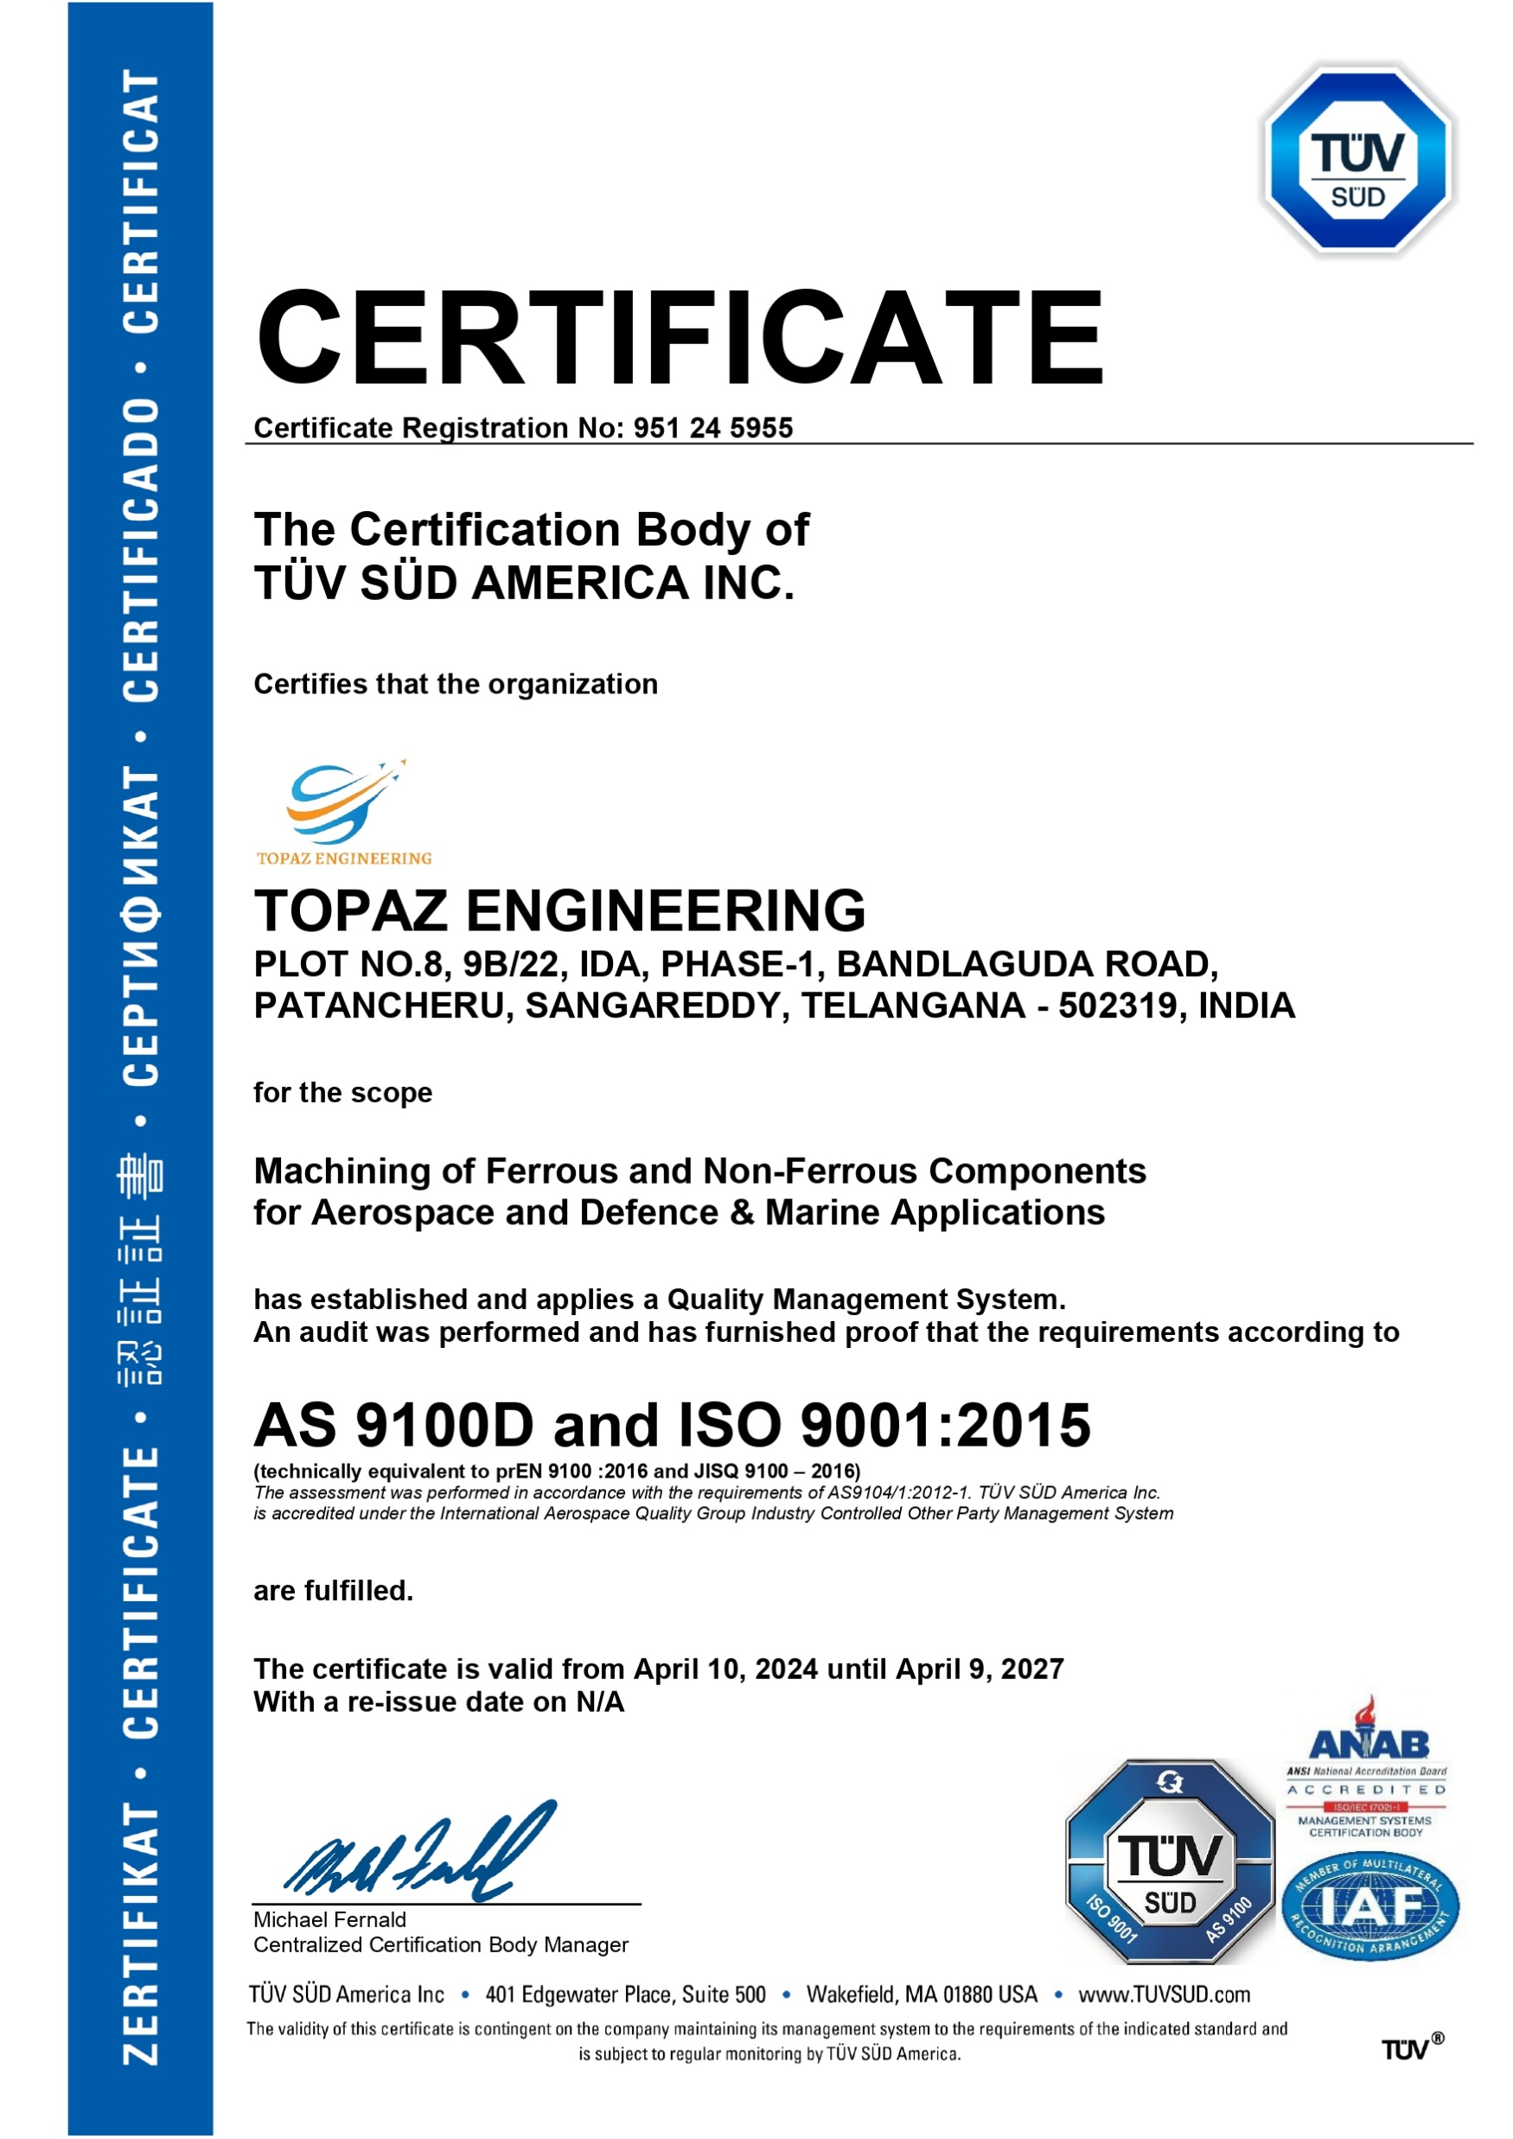
QUALITY CONTROL DEPARTMENT
We are ISO 9001:2015 & AS 9100D certified company
We have Designed & Developed a Quality Management System
Implemented, Reviewed and audited time to time.
We Practice Advanced test Procedures including NDT/DT & Functional Tests

Slide 12
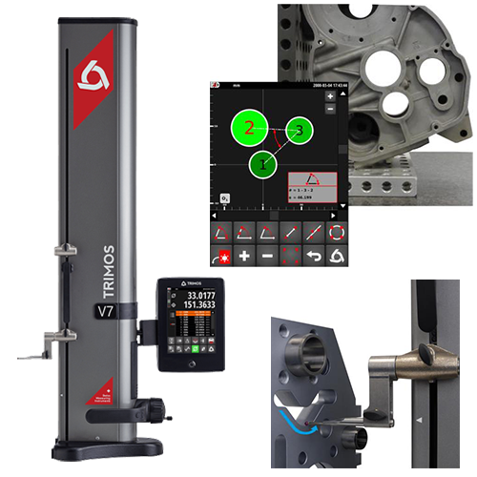
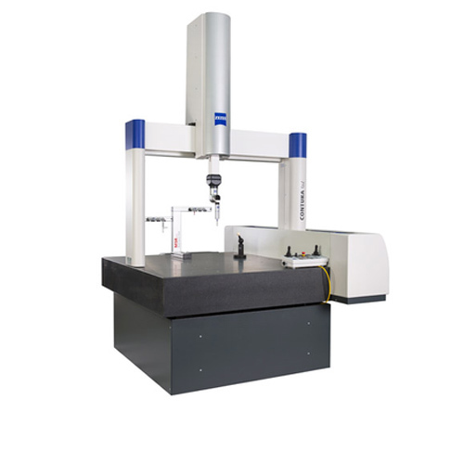
TRIMOS HEIGHT GAUGE & ZEISS CMM
TRIMOS HEIGHT GAUGE V3
ZEISS CMM SIZE: 1600x1200x600

Slide 13
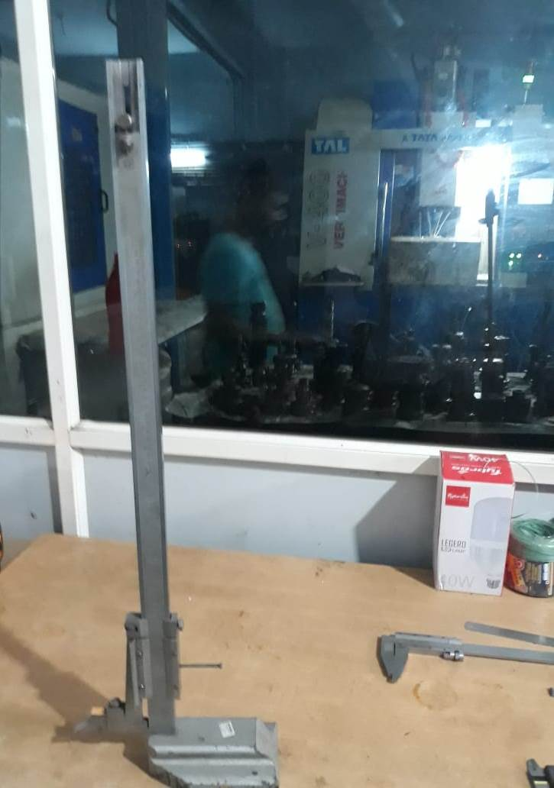
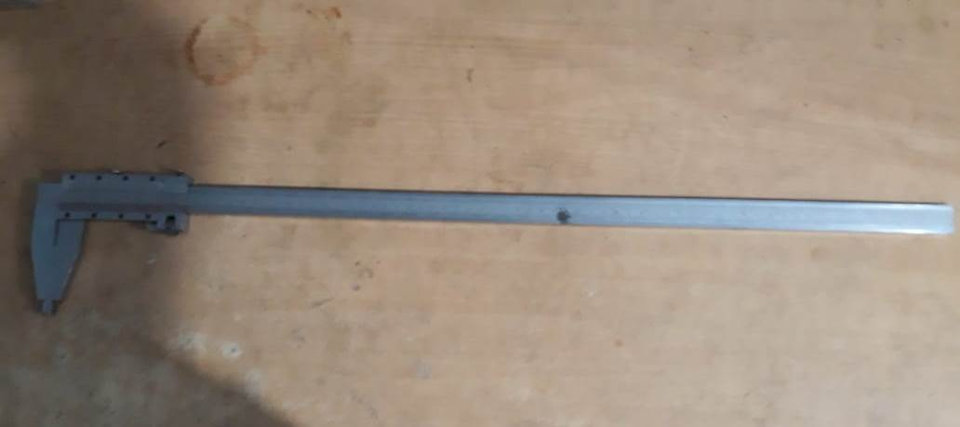
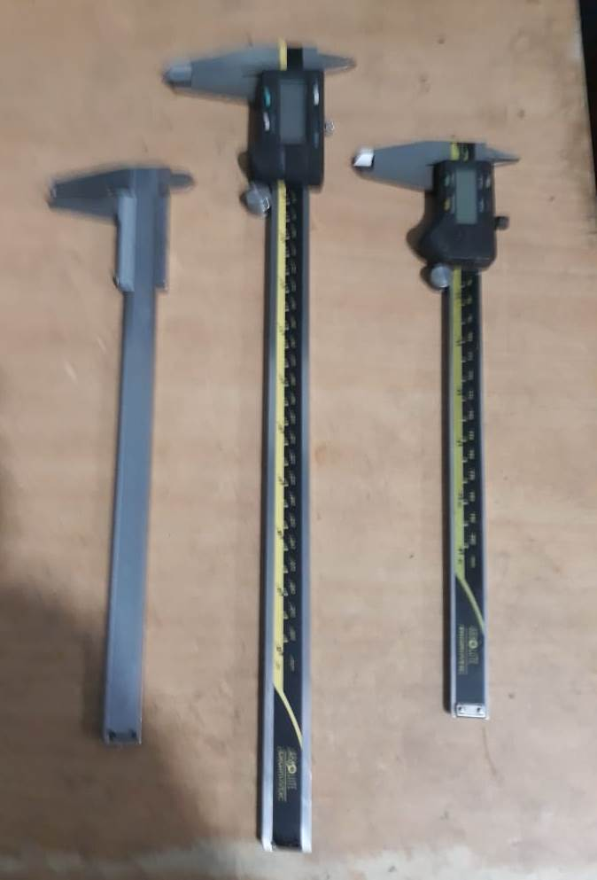
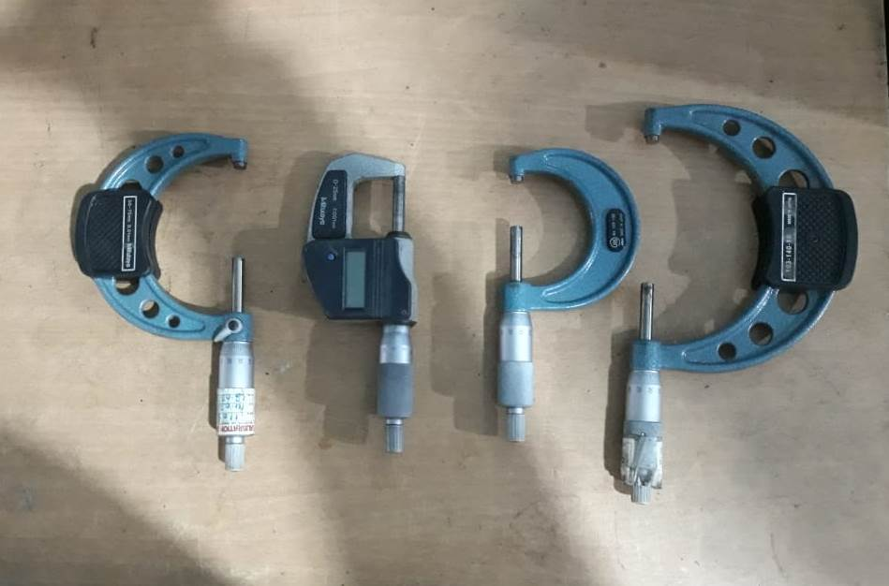
QUALITY CONTROL INSTRUMENTS

Slide 14
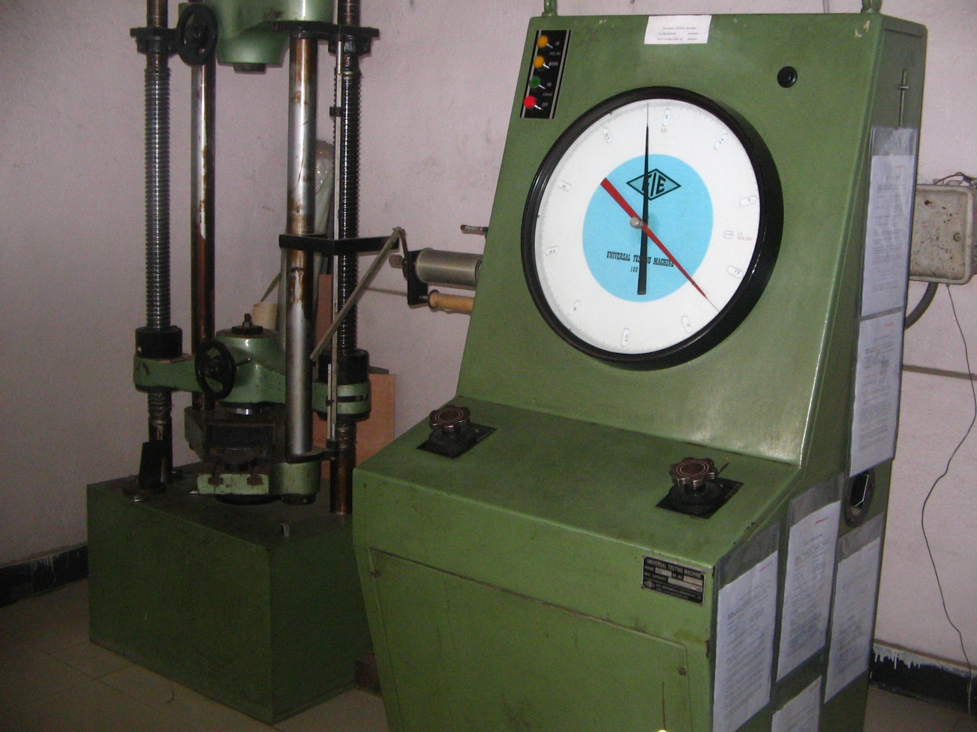
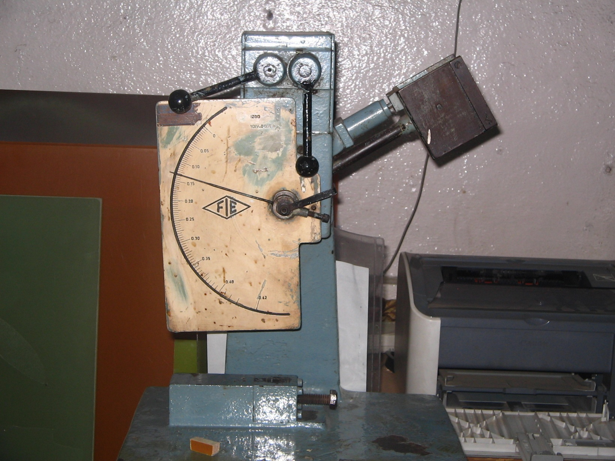
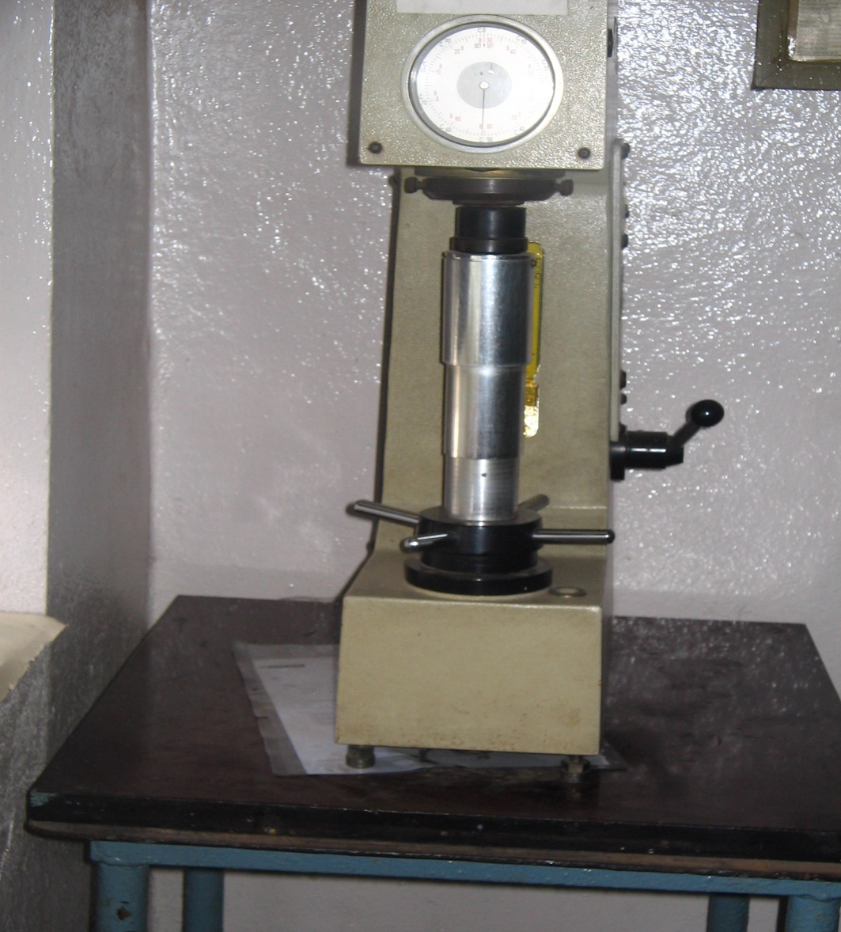
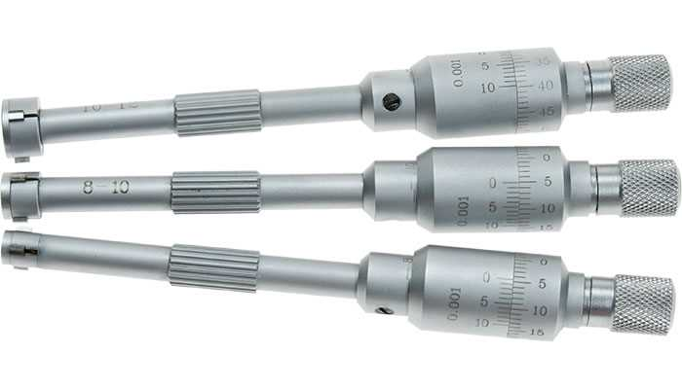
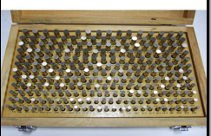
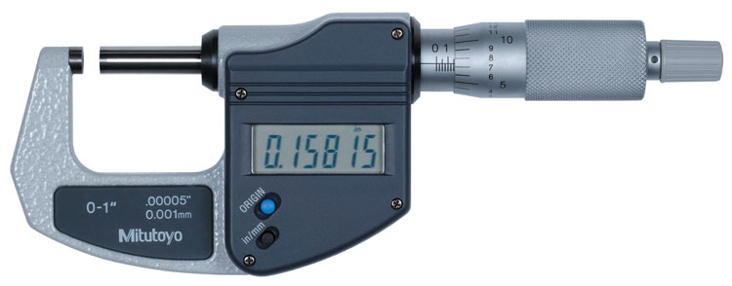
QUALITY CONTROL INSTRUMENTS

Slide 15
METROLOGY INSTRUMENTS
SNO | DESCRIPTION | SPECIFICATION | QUANTITY
1 | ZEISS CMM(with advanced features) | ZEISS 1600 X 1000 X 600 | 1
2 | TRIMOS (SWISS MAKE) | 2D-HEIGHT MASTER (0-700MM) | 1
3 | Surface Table | Micron Instruments 1600 x 650mm | 2
4 | Digital Vernier Calipers | 0 to 150MM | 3
5 | Digital Vernier Calipers | 0 to 300 MM | 1
6 | Micrometers | 0 to 25MM 25 to 50MM 50 to 75MM 75 to 100MM 25 to 50MM 100 to 125 MM 125 to 150MM | 1 1 1 1 1 1 1
7 | 2D Height Master | TRIMOS( 0 TO 700MM ) | 1
8 | Pin Gauges | 0.5 to 7MM | ASSORTED
9 | Slip Gauges | 0.5 to 100MM | ASSORTED

Slide 16
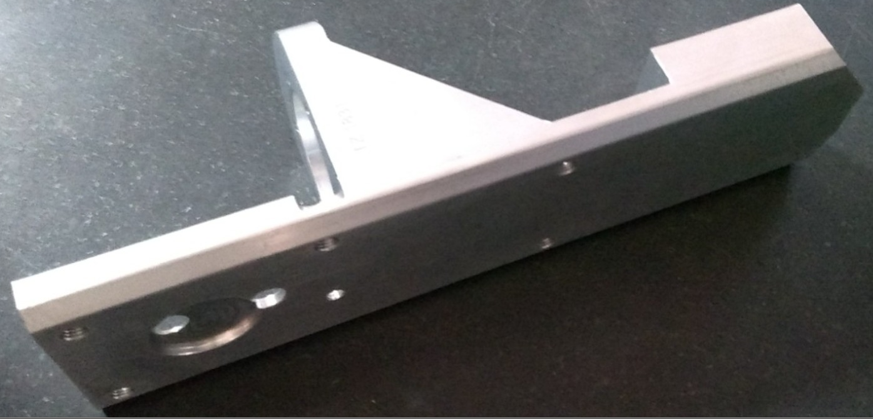
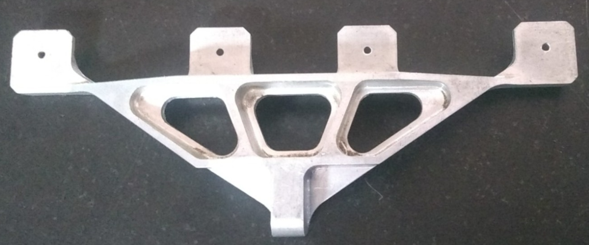
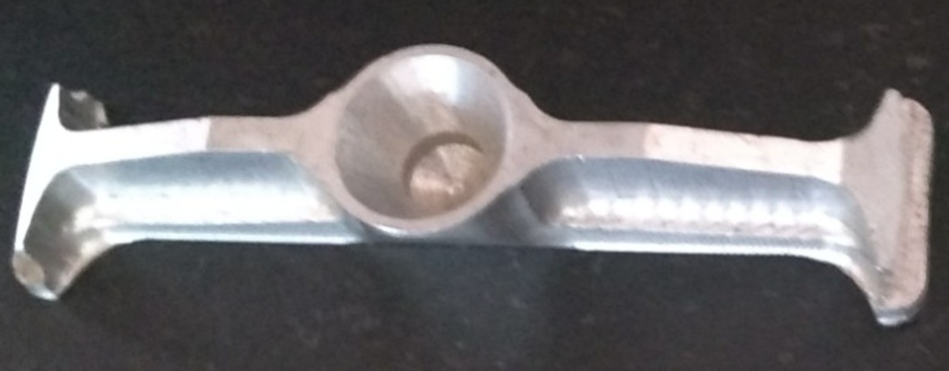
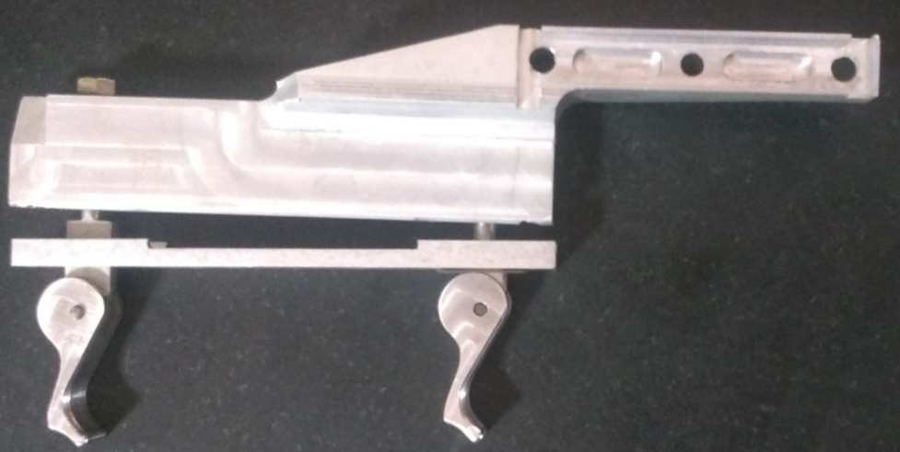
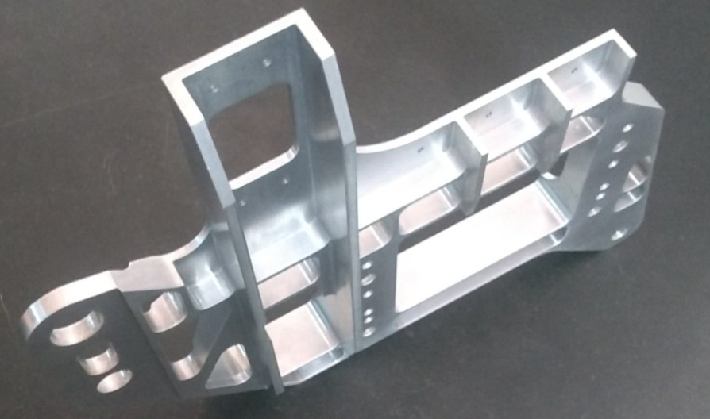
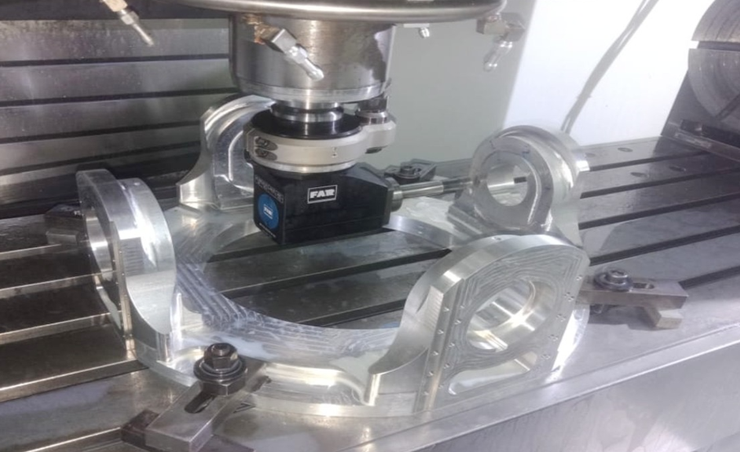
PRODUCTS PRODUCED

Slide 17
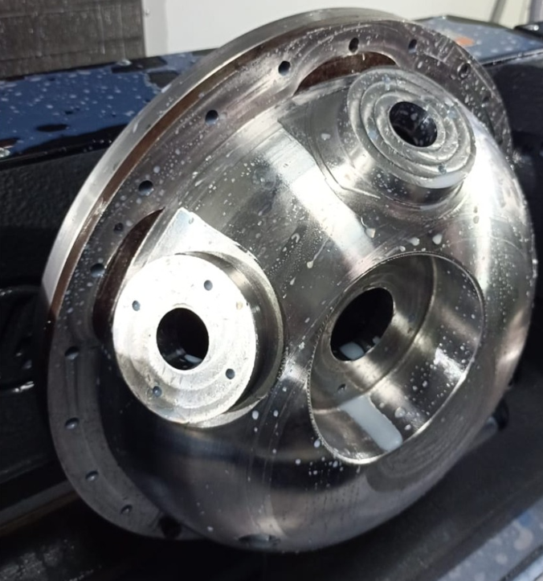
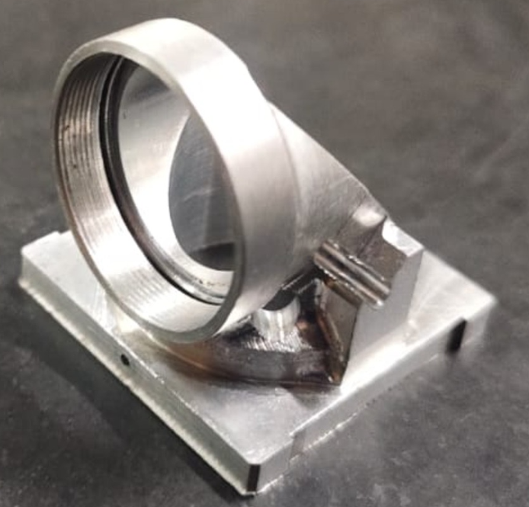
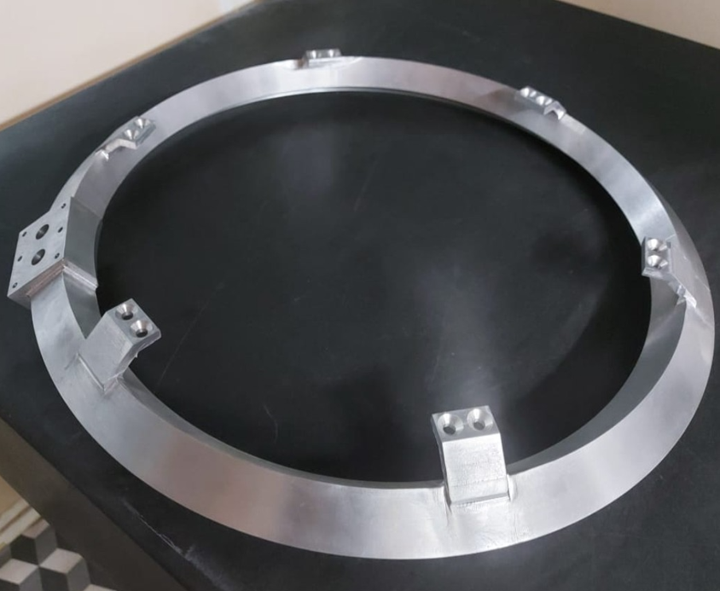
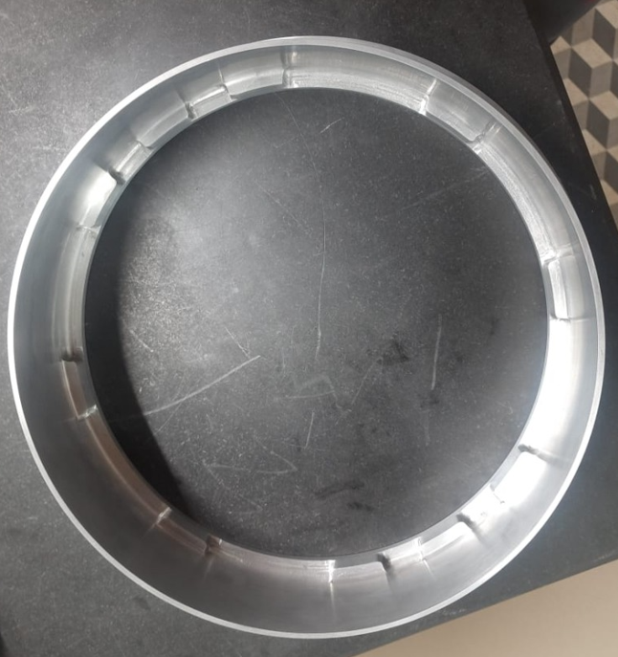
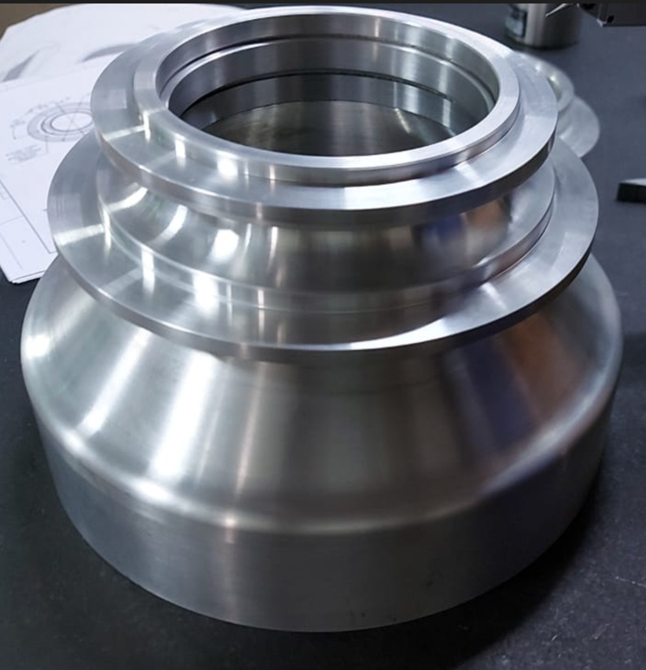
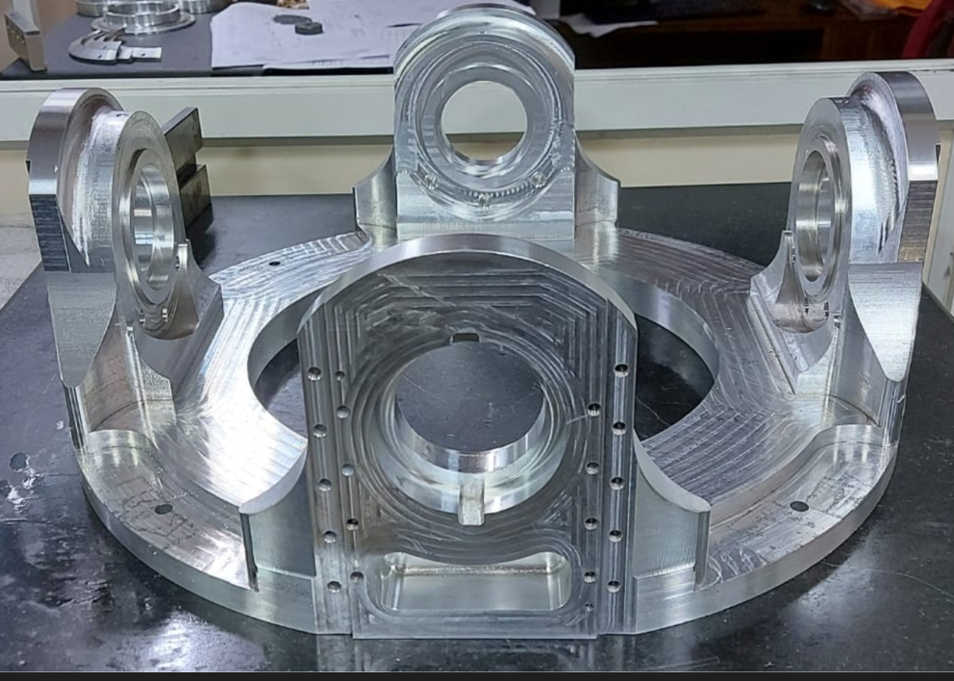
PRODUCTS PRODUCED

Slide 18
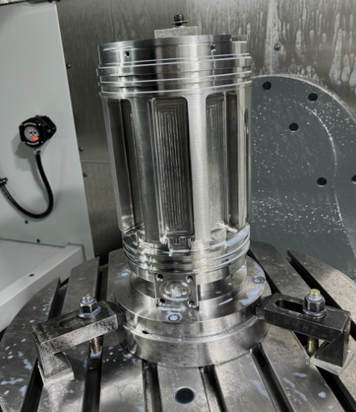
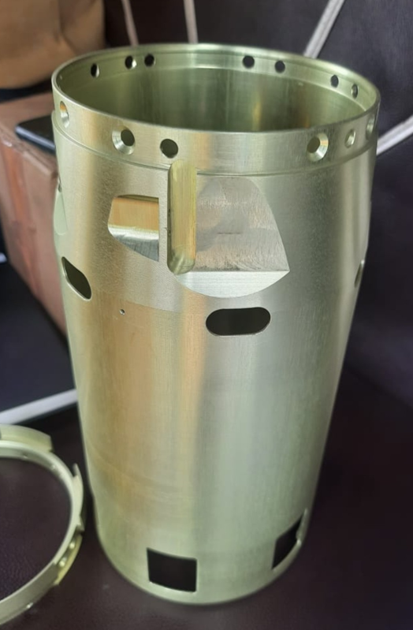
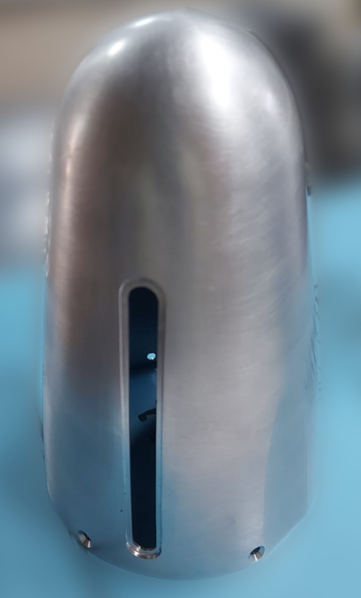
PRODUCTS PRODUCED

Slide 19
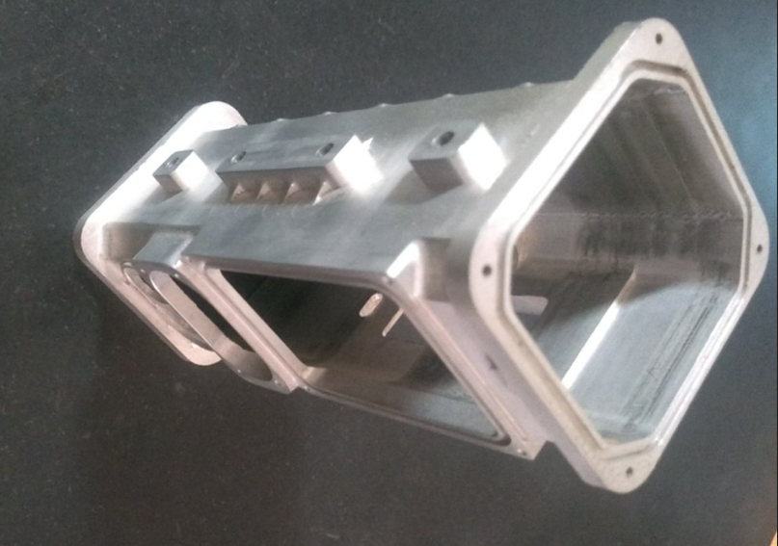
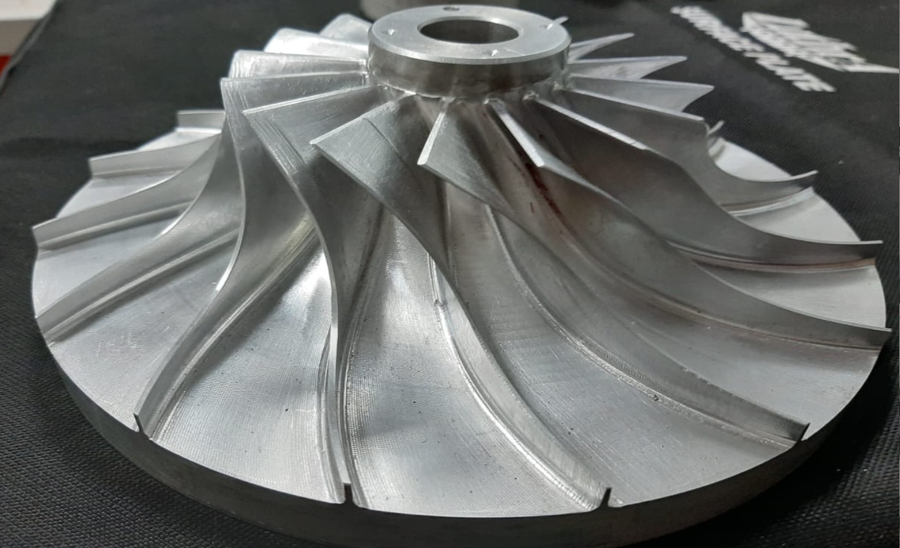
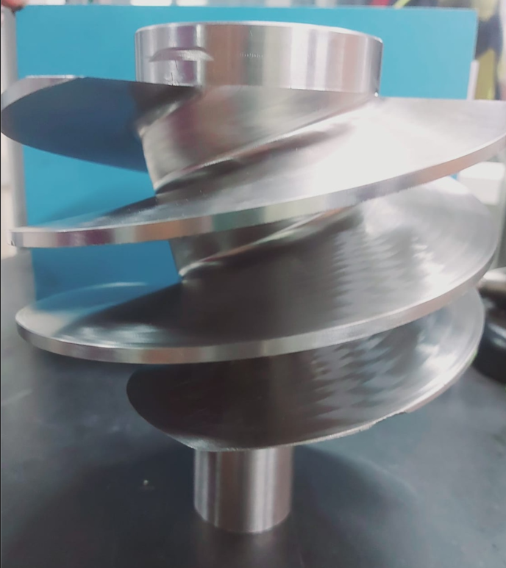
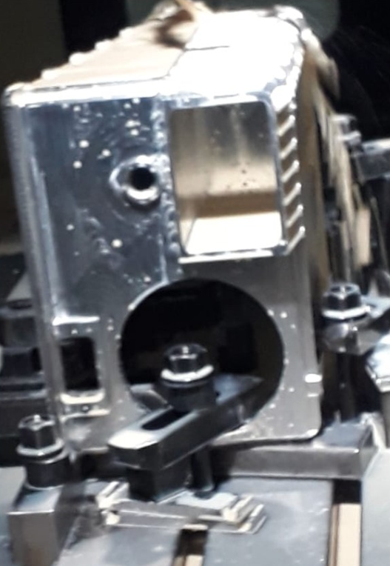
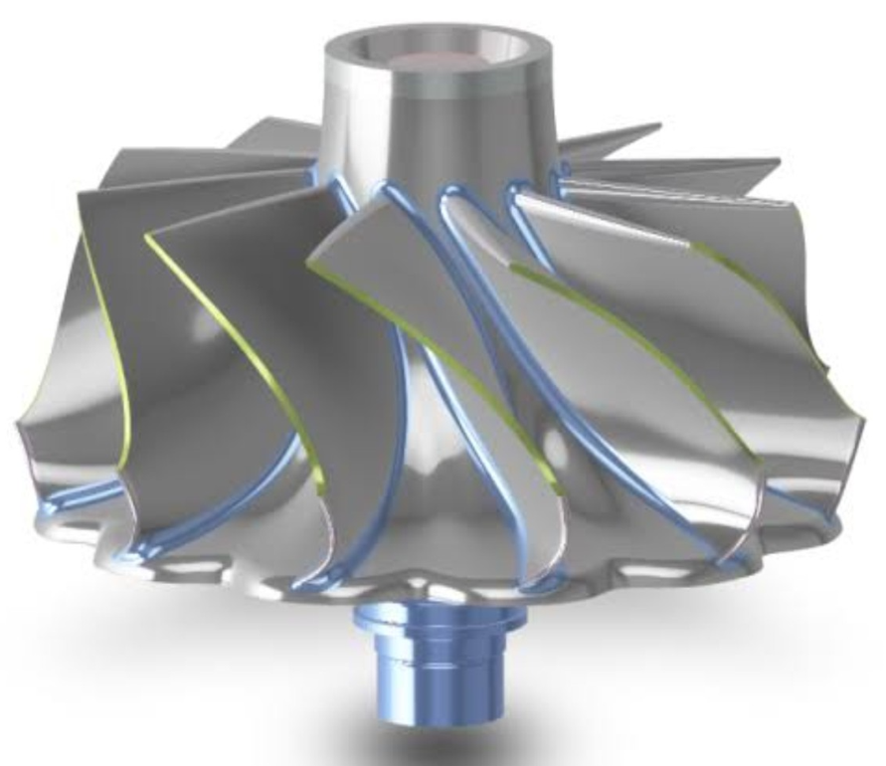
PRODUCTS PRODUCED

Slide 20
CUSTOMERS
Bharat Dynamics Limited
DRDO
ECIL
BEL
HAL
NUCON AEROSPACE
BHEL
Indian Railway
TATA AEROSPACE
BrahMos
ISRO

Slide 21
ANNUAL TURNOVER
FINANCIAL YEAR | TURNOVER (IN LAKHS)
2023-24 | 535
2022-23 | 320
2021-22 | 285
2020-21 | 180

Slide 22
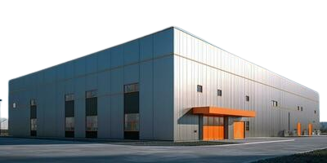
FUTURE EXPANSION
TOPAZ AEROSPACE PVT LTD
Located in Adibatla, 38000 sqft ( Production and Associated service facilities)

Slide 23
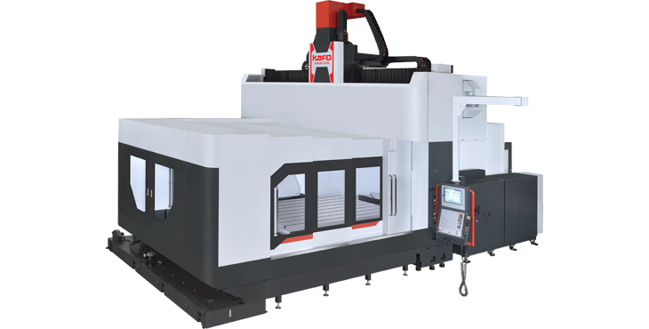
CAPITAL EQUIPMENT
Model: KG5A-2232
Controller: Heidenheimer TNC640
X/Y/Z axis travel: 2,200/3,200/1,100mm
Dist. Between column: 4,000mm
Dist. from spindle to nose: 200-1,300mm
Table size: 2,100x3,100mm
Table loading: 2,500kgs
Spindle motor: 25/30KW
Spindle speed: 12,000rpm(built-in type)
Machine size: 3,200/8,000/5,800mm
Machine weight: 61,000kgs
3 axes linear roller guide way
KAFO GANTRY TYPE 5 AXES CNC DOUBLE COLUMN MACHINE

Slide 24
CAPITAL EQUIPMENT
Our Future Added Machine
Suitable for the processing needs of large castings, structural parts, semiconductor cavity equipment, aerospace transportation parts, energy and other industries.
Benefits:
Precision and Accuracy
Versatility
Efficiency
Consistency
Space Utilization
KAFO GANTRY TYPE 5 AXES CNC DOUBLE COLUMN MACHINE

Slide 25
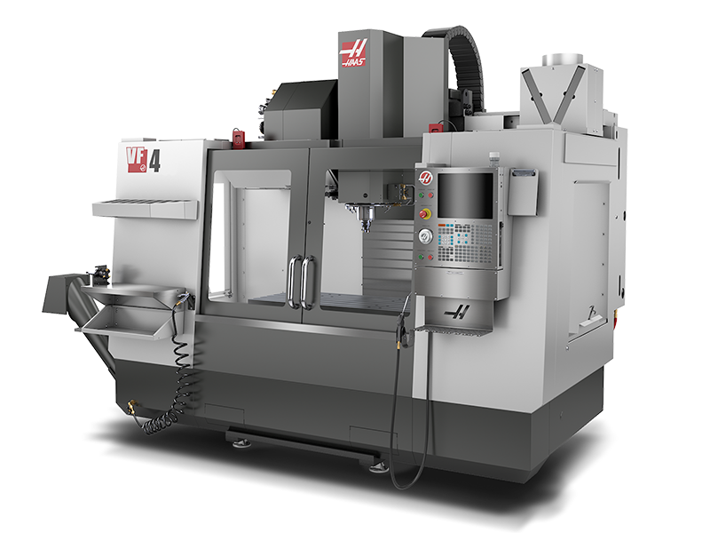
CAPITAL EQUIPMENT
Model: HAAS VF4
TABLE SIZE: 1320x500
MACHINE TRAVELS(X/Y/Z): 1270x 500 x 620
40 TAPER
22.4 KW VECTOR DRIVE
20 STATION CAROUSEL TOOL CHANGER
HIGH POWER DIRECT DRIVE SPINDLE
POWER FAILURE DETECTION MODULE
HAAS VF4 4TH AXIS MACHINE

Slide 26
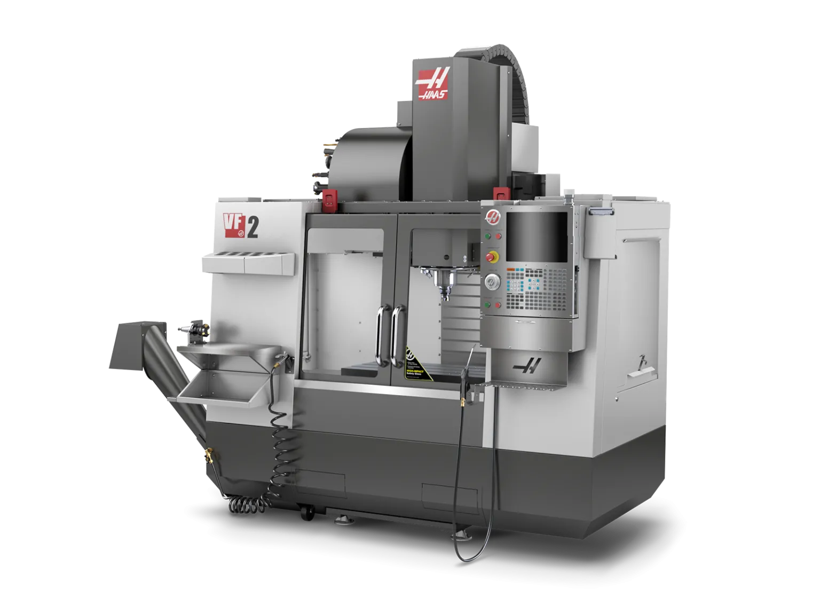
CAPITAL EQUIPMENT
Model: HAAS VF2 VERTICAL MACHINING CENTRE 4TH AXIS
TRAVEL DISTANCE X-AXIS: 762MM
TRAVEL DISTANCE Y-AXIS: 406MM
TRAVEL DISTANCE Z-AXIS: 508MM
TABLE: 915 x 457MM
HAAS VF2 4TH AXIS MACHINE

Slide 27
THANK YOU

